Slide 1

Gatling
The best developer tool to load test your web applications

Slide 2

Introduction
Amount of user our system can serve at the same time.
Load test
Response time

Slide 3
Features
1
Scenario
2
Assertion
3
Timing and report
4
Specs and debugging

Slide 4
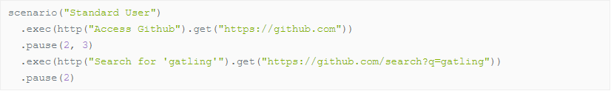
Scenario

Slide 5
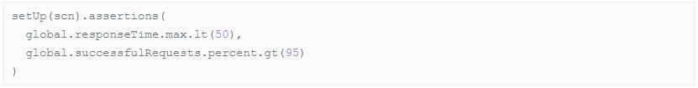
Assertion

Slide 6
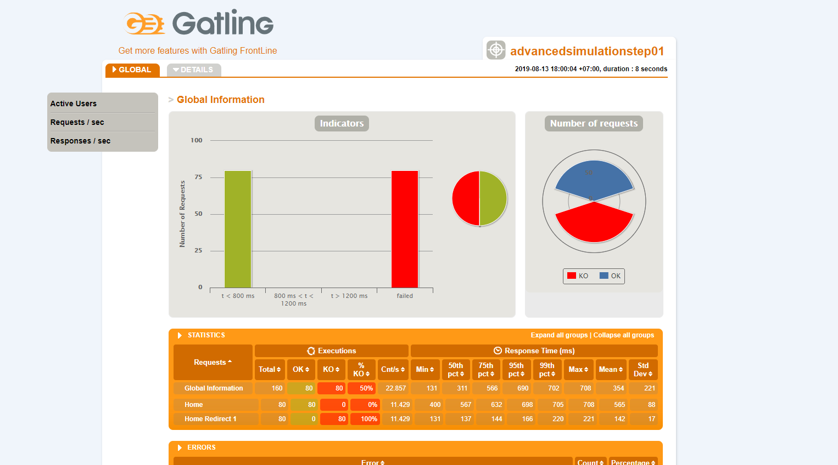
Timing and report

Slide 7
Specs and debugging
Print line
Logback

Slide 8
Gatling vs JMetter
Gatling | JMeter
All features are open source | Has lots of features which open source
Java | Scala
Does not have good dashboard | Have dashboard with real time monitoring
GUI | Based on command line runner
A bit difficult to use | Easy to use and integrate
Only HTTP protocol | HTTP protocol and a few other protocols

Slide 9
Why should we choose Gatling?
Scala
Easy to use and integrate
Real time monitoring

